Slide 1
Victoria's Roadmap
From 6pm Friday 29 October 2021
At 80 per cent double dose, Victoria will enter Phase C

Slide 2
From 6pm on Friday 29 October 2021 there will be new state-wide settings under Phase C of the
Roadmap: Delivering the National Plan
Eased density and capacity limits, if workers and customers are fully vaccinated
Face masks remain mandatory indoors but no longer required outdoors, unless unable to physically distance
Every business in Victoria with on-site operations is required to have a COVIDSafe Plan
Businesses with electronic record keeping requirements must encourage customers to check-in with the Victorian Government QR code

Slide 3
All of Victoria
Most indoor settings, including restaurants, pubs, gyms and hairdressers will open with a DQ4 (one person per four square metres) limit, if all staff and patrons are fully vaccinated.
Most outdoor settings will be at DQ2 (one person per two square metres) up to 500, where staff and patrons are fully vaccinated.
Retail
Customers attending general retail (e.g. clothing store) and essential retail (e.g. supermarket) will not be required to provide proof of being fully vaccinated at this stage.

Slide 4
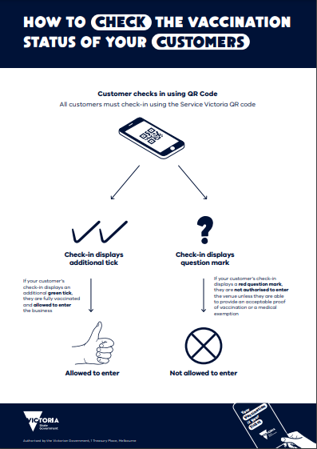
Checking vaccination status
A variety of businesses must verify their customers’ vaccination status.
If the customer has uploaded their COVID-19 Digital Certificate to their Service Victoria app, you will be able to see their vaccination status together with their check-in details.
There are new posters and other resources to help you, including posters for checking digital vaccination certificates. For more information, visit Checking customers' vaccination status.

Slide 5
Proof of exemption
that from 6pm, Friday 29 October, only the Australian Immunisation Register medical exemption form is to be used to provide patients proof of a medical exemption to any vaccination requirements in Victoria.
If there are people with an exemption letter that isn't the Australian Immunisation Register form – such as just a standard doctor's certificate – they will need to return to their medical practitioner to submit the form by 12 November. They can continue to use a doctor's certificate up to that date.
Those who don't meet the specific medical contraindications to COVID-19 vaccination according to ATAGI guidance will not have a valid exemption after 12 November.

Slide 6
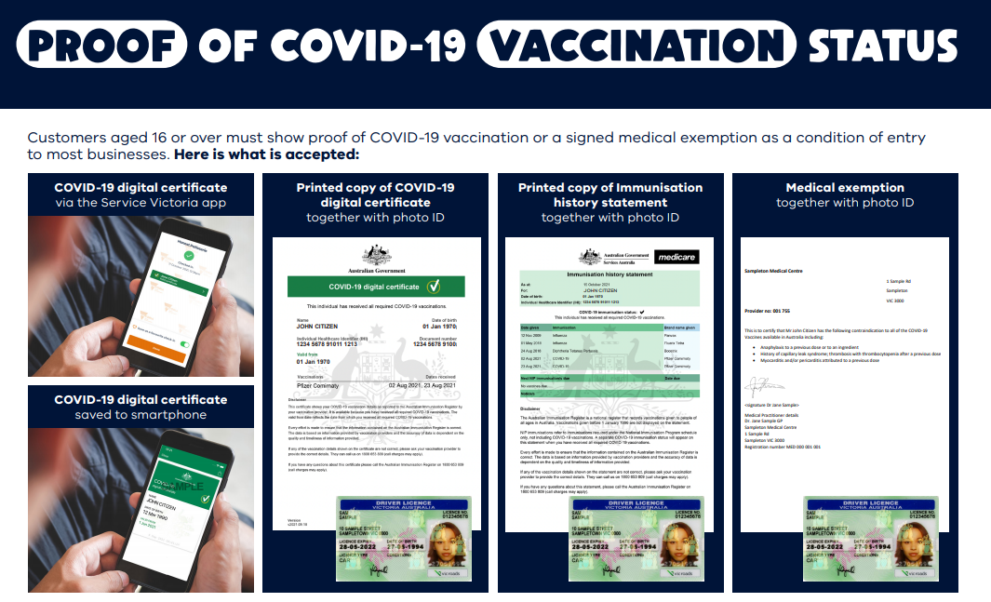
From 12 November exemption must be via Australian Immunisation Register

Slide 7
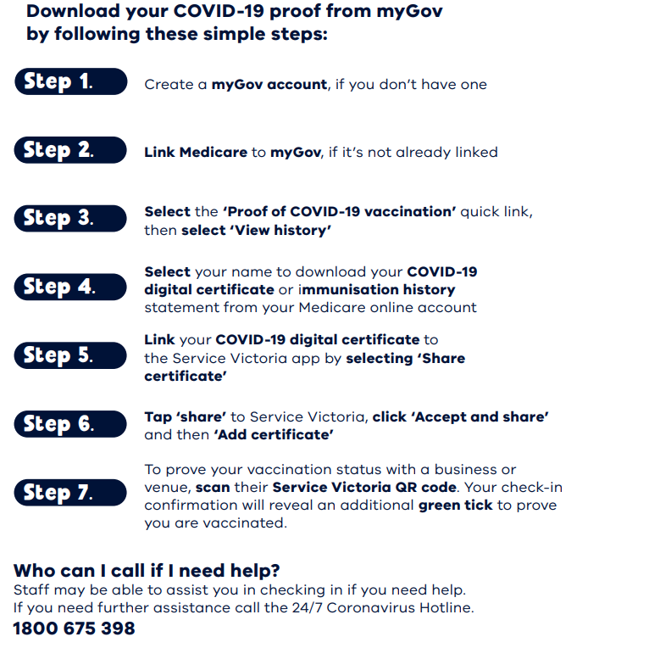

Slide 8
Risk-based approach to workplace close contacts
Businesses can now use a risk-based approach which considers the duration of the contact, mask wearing and vaccination status.
This change will result in fewer workers being away from work, ensuring the continuity of supply chains and essential services, and advancing Victoria’s broader economic recovery as the state re-opens.
Workplace primary close contacts (PCCs) are required to isolate for seven days if they are fully vaccinated.
Household and unvaccinated PCCs are still required to isolate for 14 days.
Tailored outbreak management may be required in some circumstances where significant transmission events have occurred.
For more information go to Confirmed case in the Workplace or call the Business Victoria hotline on 13 22 15.

Slide 9
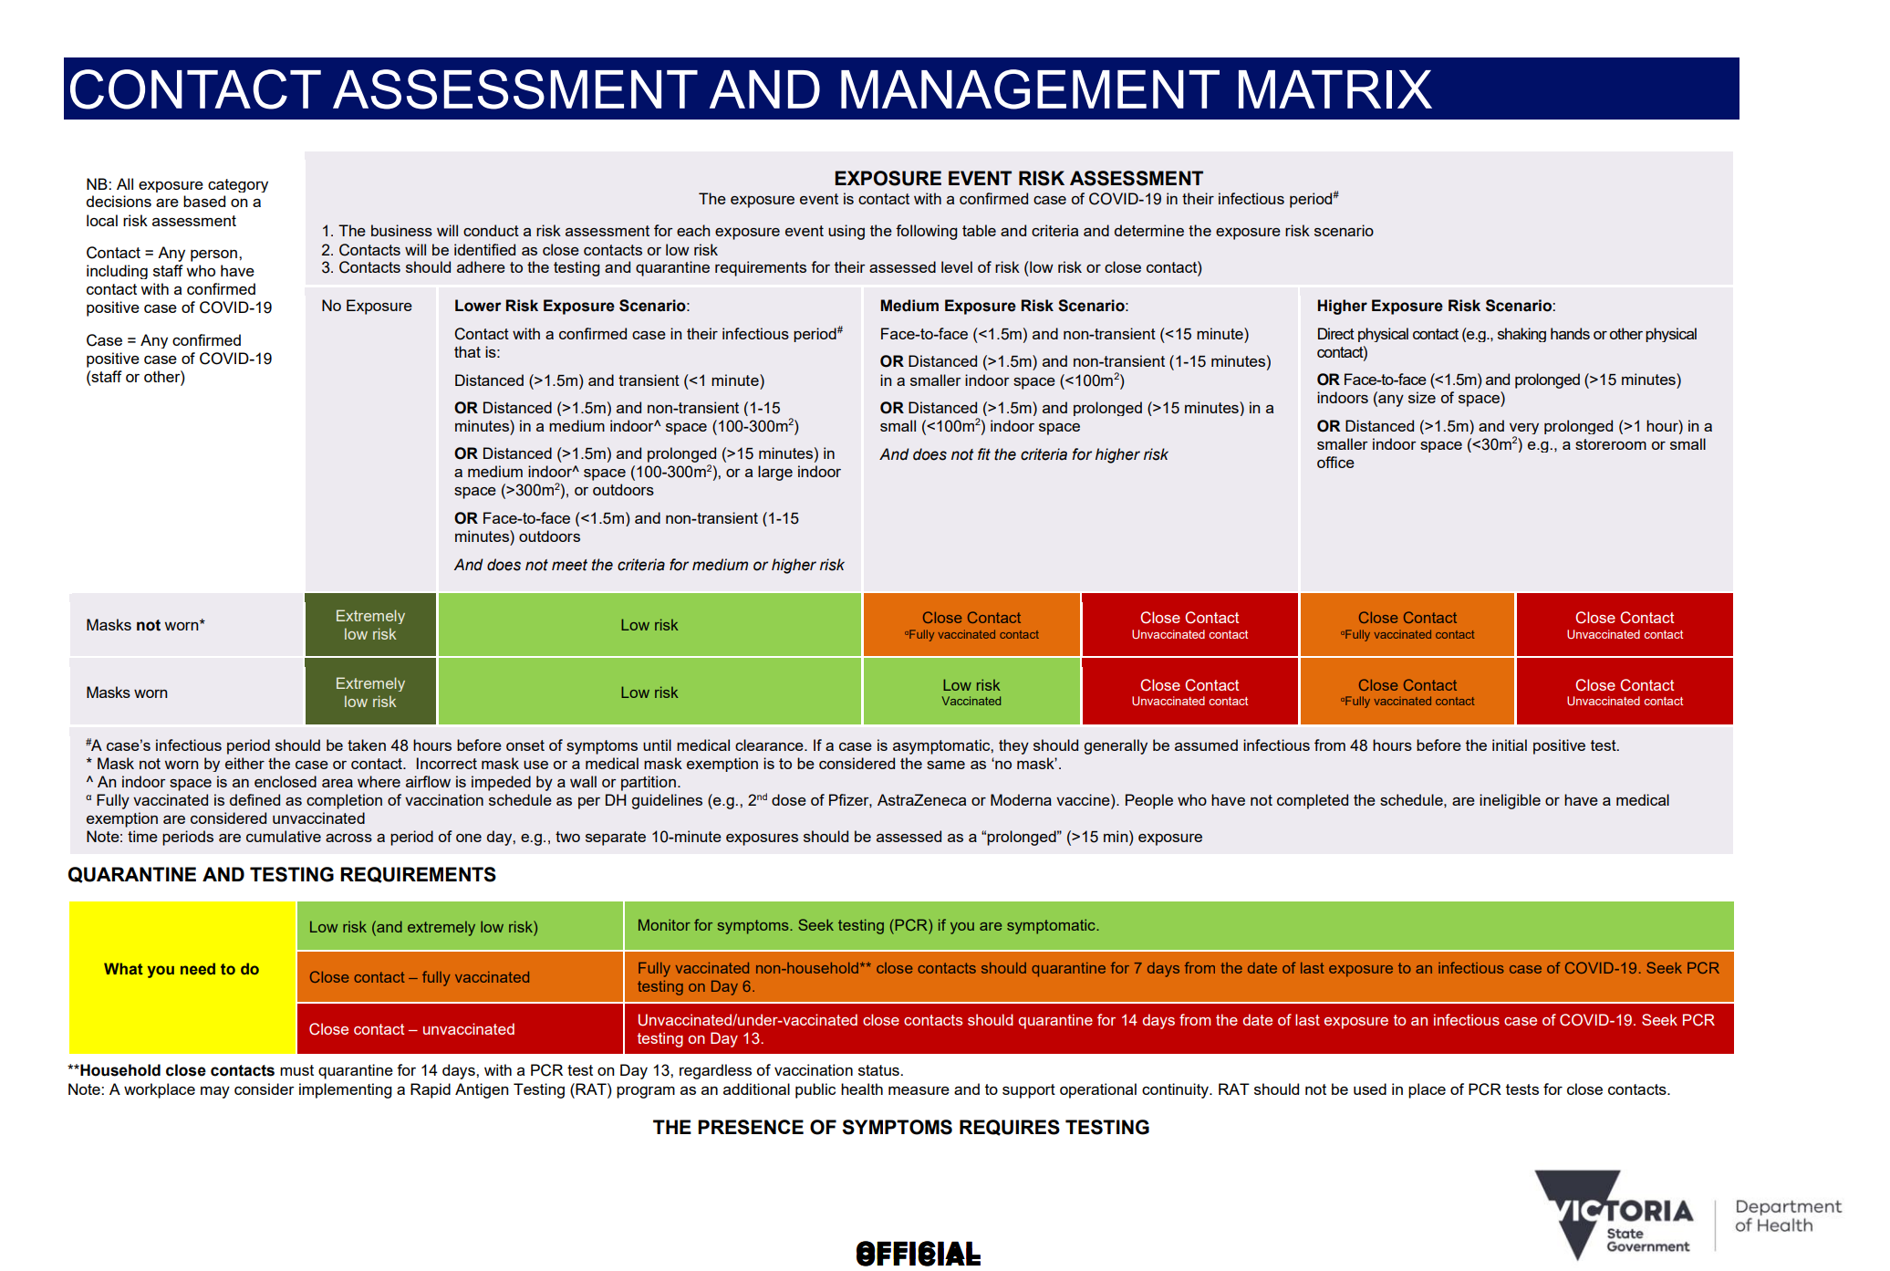

Slide 10
Enforcement and penalties
Directions are enforced by Victoria Police and use of emergency powers by the Authorised Officers
Penalties include:
  infringement notices
  improvement notices
  prohibition notices
From Monday 25 October 2021, businesses, sole traders and body corporates that fail to meet their COVIDSafe obligations can be fined between $1,090 and $27,261 based on a scale of low, medium, high and severe non-compliance
https://www.coronavirus.vic.gov.au/fines-enforcement-and-reporting

Slide 11
Breach level | Penalty
Low level breaches include: Failure to display signs mandating mask-wearing Failure to display density quotient signage Failure to maintain cleaning records or protocols Exceed density quotients by up to 50% | For individuals or sole traders: $1090 For companies or body corporates: $5452
Medium level breaches include: Failure for staff to wear masks without lawful exemption Failure to display QR code signage at each entrance | For individuals or sole traders: $2181 For companies or body corporates: $10,904
High level breaches include: Failure to have a QR code system in place or failure to use Service Victoria as the approved QR code check-in system Failure to require visitors or patrons to check-in Failure or inadequate use of a COVID Marshal Failure to have a COVIDSafe Plan in place | For individuals or sole traders: $4362 For companies or body corporates: $21,809
Severe level breaches include: Operating during lockdown Not adhering to staff vaccination requirements Exceeding density quotients by more than 250% | For individuals or sole traders: $5452 For companies or body corporates: $27,261
Extreme level breaches may include significant, willful and blatant disregard for the Chief Health Officer Directions and COVIDSafe practices. When breaches are extreme and create significant risks to public health, then they may be taken before the courts. | For individuals or sole traders: prosecution and fines of up to $21,809 For companies or body corporates: prosecution and fines of up to $109,044

Slide 12
Creating a COVIDSafe workplace
Helping Victorian small businesses operate safely

Slide 13
Every business that is open must have a COVIDSafe Plan
This will help businesses to safely open and operate in accordance with current restrictions.
Your COVIDSafe Plan will be built on the six COVIDSafe principles:
    Ensure physical distancing
    Wear a face mask
    Practise good hygiene
    Keep records and act quickly if workers become unwell
    Avoid interactions in enclosed spaces
    Create workforce bubbles

Slide 14
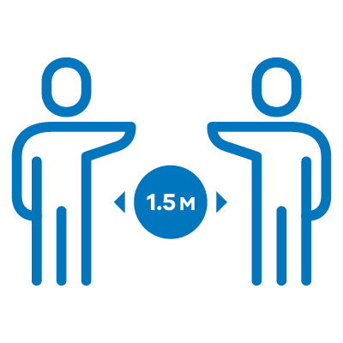
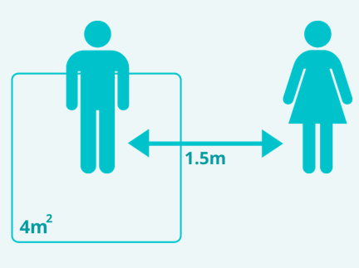
1. Ensure physical distancing
Requirements | Action Examples
Workers and visitors must stay 1.5 metres apart wherever possible. | Rearrange or remove furniture to comply with physical distancing.
Follow the density quotient: allow only one worker/customer per four square meters of enclosed workspace | Display signs at the entrance to show patron limits
Train staff to follow physical distancing rules and car-pooling restrictions | Stagger seating to allow your staff to maintain their distance
Allocate different doors for entry and exit to minimise queues. | Mark the floor or install barriers to direct customer flow and help everyone stay 1.5 metres apart
Minimise the number of workers who deal with a customer | Make sure the only staff at work are those who need to be there

Slide 15


2. Wear a face mask
Requirements | Action Examples
Ensure all workers and visitors wear an approved face mask when required | Display signs to encourage anyone entering to wear an approved mask. An approved face mask has at least two layers.
Provide staff with a face mask if they do not have one. | You can buy affordable disposable or reusable masks in most supermarkets and online.
Train staff in how to correctly fit, use and dispose of their face masks and PPE. | Lead by example - make sure your mask is fitted and always covers your nose and mouth. Staff must not remove their masks to talk to people in the store or on the phone.
Install screens and barriers where relevant. | Help to prevent infection by installing plastic barriers in commonly used areas, such as at cash registers

Slide 16


3. Practise good hygiene
Requirements | Action Examples
Provide hand sanitiser, soap and handwashing facilities for staff and customers | Use hand sanitiser and sanitise anything you touch that others might touch
Regularly clean and disinfect shared spaces and frequently touched surfaces. | Clean frequently touched surfaces (such as door handles, handrails, shelves, counters, touch screens and shared work equipment) with disinfectant
Regularly clean between shifts and display a cleaning log in shared spaces. | Clean regularly, with detergent or disinfectant. Monitor your cleaning supplies and restock regularly
Replace high-touch communal items with hygienic alternatives. | Use single-use or contactless options, (for example, disposable cups)

Slide 17

4. Keep records and act quickly if workers become unwell
Requirements | Action Examples
Support workers to get tested and stay at home if they are unwell – even if their symptoms are mild. | Advise your staff that financial support is available if they cannot work while waiting for results.
Use the Confirmed Case in the Workplace process and workplace risk matrix to manage a confirmed case in the workplace | Establish a process for notifying workers, close contacts, DHHS, WorkSafe and your health and safety representatives about a positive result.
Have a Service Victoria QR Code and ensure workers and clients check in | Decide who is responsible for carrying out the process.
Follow all mandatory vaccination requirements for your industry and maintain records of staff vaccination status | Sight and document staff vaccination status Use QR Code app to check customer vaccination status
Contact DHHS and notify WorkSafe Victoria on 13 23 60 if someone at your business tests positive to coronavirus (COVID-19). | Have a plan to clean the workplace in the event of a positive case.

Slide 18




5. Avoid interactions in enclosed spaces
Requirements | Action Examples
Reduce the time workers spend in enclosed spaces. | Hold meal breaks and meetings outdoors when you can.
Work outdoors when possible, including serving customers. | Set up outdoor service points where feasible.
Increase the airflow in your workplace with open windows and doors | At the start of every workday, open all windows and doors
Ensure air-conditioning systems are on fresh not recycled air (including in vehicles) | Look for symbols like these on your aircon and in your vehicle

Slide 19


6. Create workforce bubbles
Requirements | Action Examples
When rostering, don’t overlap workers during shift changes | Maintain 'bubbles' for your staff by ensuring shift changes don't overlap
Keep groups of workers rostered on the same shifts at a single worksite. | Within a shift, stagger break times to avoid crowding common areas
Keep records of workers who disclose they reside with another worker. | If members of your staff live at the same address, put them on the same shifts.
Maintain records of all workers who have more than one employer across more than one worksite. | Limit the number of workers working across multiple sites when possible.

Slide 20
Your COVIDSafe Plan must set out:
The actions you will take to prevent the introduction of coronavirus (COVID-19) to your workplace.
The type of face mask or personal protective equipment (PPE) your workforce needs.
How you will prepare for and respond to a suspected or confirmed case of coronavirus (COVID-19) in your workplace
How you will meet all the requirements set out by the Victorian Government.

Slide 21
Review your COVIDSafe Plan regularly
Public health advice and related restrictions can change.
Review and update your COVIDSafe Plan regularly to make sure you comply with current regulations and health requirements.
Organisations with multiple worksites must complete a COVIDSafe Plan for each worksite.
Note that some higher-risk industries or workplaces have additional requirements.
Download the latest fact sheets and resources to help you update your COVIDSafe Plan and to display at your workplace
https://www.coronavirus.vic.gov.au/signs-posters-and-templates#business-display-posters-and-flyers

Slide 22
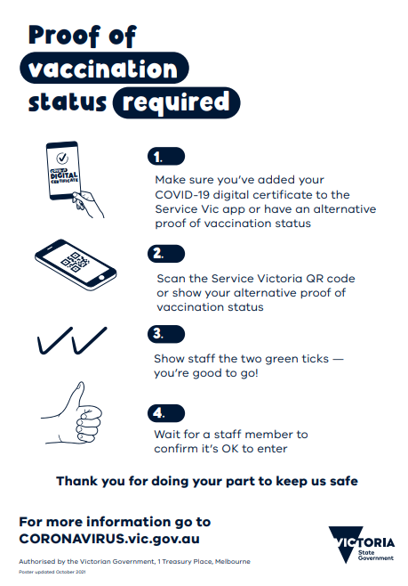
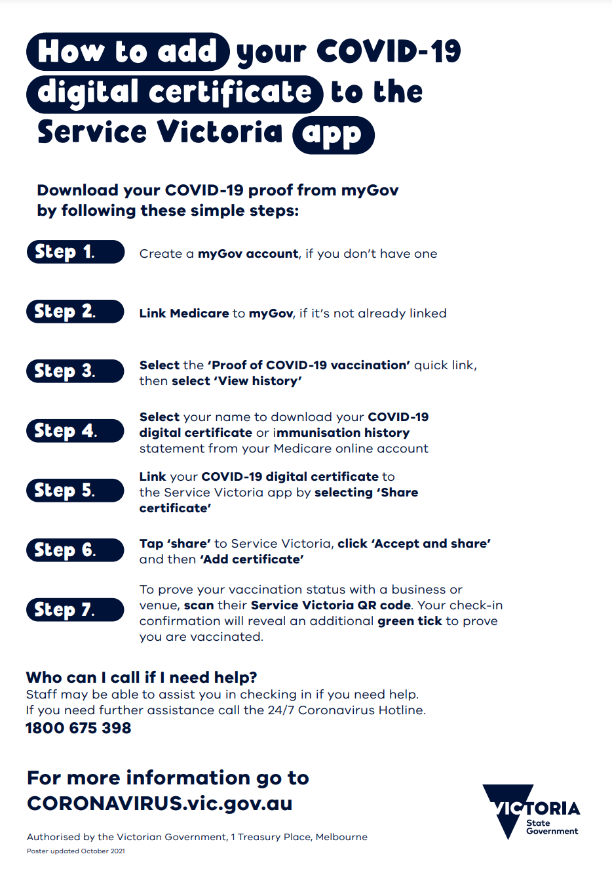

Slide 23

What to do if you are showing symptoms of coronavirus (COVID-19) at work
Go home and do not go to work
Get tested
Financial support is available
while you wait for test results
Only return to work once you have received a negative test result
Example of a poster available for download from coronavirus.vic.gov.au

Slide 24
What should I do if a worker tests positive for coronavirus (COVID-19)
Notify close contacts
Do a comprehensive clean
Notify Worksafe Victoria 13 23 60
Notify DH and seek advice 1800 675 398
Example of a poster available for download from coronavirus.vic.gov.au

Slide 25
Financial support for Victorian workers
Financial support is available to Victorian workers who are waiting for test results or self-isolating.
The $450 Coronavirus (COVID-19) Test Isolation Payment supports Victorian workers, including parents and guardians, who are required to self-isolate while waiting for the results of a coronavirus (COVID-19) test.
The $1500 Coronavirus (COVID-19) Worker Support Payment is now offered through the Commonwealth Government’s Pandemic Leave Disaster Payment for Victoria.
Please share this information with your workers.
https://www.dhhs.vic.gov.au/covid-19-worker-support-payment

Slide 26
How to create your COVIDSafe Plan
Visit https://www.coronavirus.vic.gov.au/covidsafe-plan
for templates and guidance on creating a COVIDSafe Plan for your small business.
For more information, visit coronavirus.vic.gov.au
or call the Business Victoria Hotline on 13 22 15
You can request a free translator by calling 13 22 15
Every Victorian business must have a COVIDSafe Plan.

Slide 27
Free COVIDSafe Plan Review
The Victorian Government is offering a free, independent review of your COVIDSafe Plan to ensure it is up to date and reflects the current COVIDSafe settings. Advice from leading professional services firm Ernst & Young
Advice from leading professional services firm Ernst & Young will include:
Consideration of your COVIDSafe Plan and any relevant information.
Contact you to discuss how you have implemented the plan.
Provide confidential advice on how to address any gaps or areas for improvement.
How to book a free COVIDSafe Plan review?
Email covidsafeplanreview@djpr.vic.gov.au
Provide the following:
  your Business name
  the name of the best person to contact, and
  their phone number.

Slide 28
Resources
Managing stress and wellbeing
Posters and signs for a COVIDSafe workplace
Victoria's Roadmap: Delivering the National Plan
Business grants and support
VIDEO: How to add your vaccine certificate to your Service Vic app.
Information for industry and workers required to be vaccinated
Call the Business Victoria Hotline on 13 22 15 Industry questions can be emailed to: icc@ecodev.vic.gov.au

Slide 29
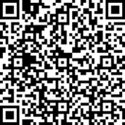
Small/Medium size business forums - Coming up
Forums – roadmap and COVID safe settings
Education webinar - Keeping your business COVIDSafe
Sessions include:
Updates on the Roadmap and restrictions settings
CHO Directions (including the vaccination requirement for workers)
Business requirements (including COVIDSafe Plans, QR codes and vaccine status check-in)
Business support services (including grants and health and wellbeing)
Contact assessment and management matrix
New signage and posters
Penalties
An opportunity for discussion and questions.
Interactive webinar sessions led by the Department of Health (DH) and DJPR
Sessions include:
• How is COVID-19 spread?
• How do I make my business COVIDSafe for my staff?
• How do I make my business COVIDSafe for my customers?
Webinar | Date | Time
Hair and beauty | Fri 5 Nov | 10:30am
Cafes and restaurants | Tues 16 Nov | 3:00pm
Forum | Date | Time
Sports & fitness – gyms etc. | Tue, 9 Nov | 3:00 PM
Markets | Wed, 10 Nov | 3:00 PM
Office-based business e.g. accountants, etc. | Fri, 12-Nov | 1:00 PM
Register online
https://forms.office.com/r/7t6zrHkNUQ

Slide 30
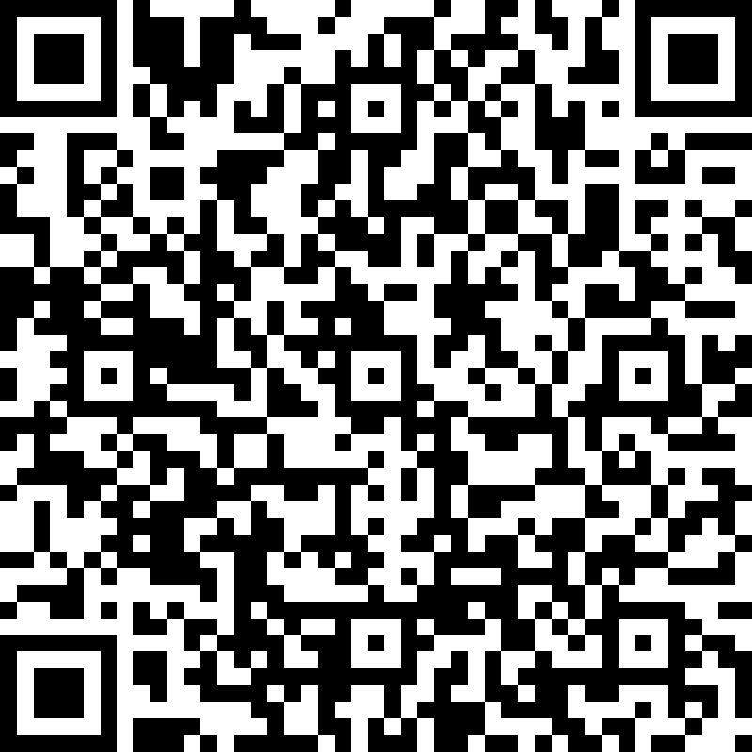
Please provide your feedback
https://forms.office.com/r/DEWjgaauvw

